Slide 1
Distributed Software Architecture
SE495: Software and Systems Integration

Slide 2
Outline
Introduction
Integration Types
Integration Models
Integrated system vs. Legacy System
Integration type
Integration Architecture

Slide 3
Enterprise Systems:
Perform enterprise activities
Management
and Support
Application Systems:
support enterprise systems
Interoperability
Distributed Computing Platform
Application Support Services (OS,
DB support, Directories, RPC)
Communication Network Services
(Network protocols, Physical devices)
Hardware
Portability
Integration
Network
Management
3

Slide 4
Enterprise Systems:
Engineering systems
Business systems
Manufacturing
Office systems
Management
and Support
Application Systems:
Interoperability
User
Interfaces
Processing
programs
Data files &
Databases
Portability
Distributed Computing Platform
Application Support Services
Integration
C/S Support
Dist. Data
Trans. Mgmt.
Distributed
OS
Network
Management
Common Network Services
Network protocols & interconnectivity
OSI
protocols
TCP/IP
4

Slide 5
Client-Server (Two-Tier) Architectures
The application is modelled as a set of services that are provided by servers and a set of clients that use these services;
Clients know of servers but servers need not to know of clients;
Clients and servers are logical processes: They could reside/running on different processors or on the same processor;
The mapping of processors to processes is not necessarily one to one.

Slide 6
Client-Server Systems and their Federation
Server
Virtualization of services
Virtual server A
Server
2
Server
1
Multi tenancy / Loadbalancer
database
Cloud Computing
Federation
A server also manages the database
Virtualization of services
Virtual server B
Server
3
Server
4
Multi tenancy / Loadbalancer

Slide 7
ASU Virtual Server WebStrar in AWS Cloud
Virtual
Servers
Multitenancy
One for each group
Each server has its own OS, DB, and software
Site 1
Multiple Folders for each tenant
One folder for each member
Site 2
Site Root Folder
.
.
.
Windows server, .Net 4
.
.
.
WebStrar
Site 100
Page 0
Page1
Page2
Page3
ASU SoD
Server on Demand Cloud
.
.
.
.
.
.
Page4
Page5
. . .
Page10
Site 199
No Isolation
Implemented
Isolation
Site 200

Slide 8
Thin-Client and Fat-Client Architectures
Thin-client architecture
All of the application processing and data management are carried out on the server.
The client is simply responsible for running the presentation/GUI software.
Fat-client (Thick-client) architecture
The software on the client implements the application logic and the interactions with the users.
The server is responsible for data management (database) only.
Example: Many game programs, Adobe Flash and MS Silverlight support Fat Clients, HTML5 can also support Fat Clients, where intensive processing and responsiveness are required.

Slide 9
Traditional Three-Tier Architecture
Each layer may execute on a separate processor;
A more balanced approach, which allows for better performance than a thin-client approach and is simpler to manage than a fat-client approach;
A more scalable architecture - as demands increase, extra servers can be added.
Presentation
Layer (GUI)
Application
Processing Layer
Data Management
Layer

Slide 10
Example: A 3-Tier Internet Banking System
Client
Client
Client
HTTP
HTTPS
Web Server
for account
service
provision
Data Management Layer
Client
Database server
Customer
account
database
Presentation Layer
in Client Browsers
Business Logic Layer
in server
Database requests and responses

Slide 11
Four-Tier Architecture with a Service Layer
Each layer may execute on a separate processor;
Application is largely composed of existing services, running on a different server (repository), provided by external service providers;
This is an example of Service-Oriented Architecture (SOA);
SOA does not have to be in N-Tier. It can be a tree or graph too.
Presentation
Layer (GUI)
Not accessible outside
Application
Processing Layer
In-App Data
Management
Service Repository
Layer
Data
Management
Data Management
Layer outside App
Shared by many applications

Slide 12
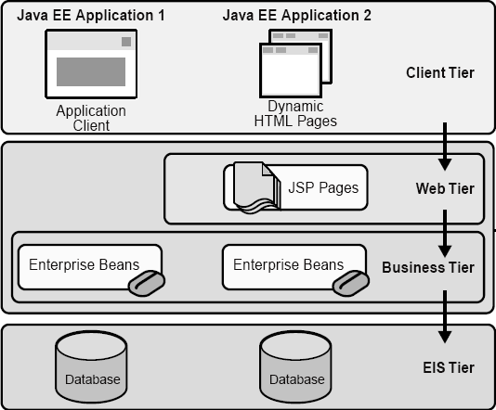
Four-Tier Architecture: Java EE Applicatio Source: Java Enterprise Edition
Client Machine
Java EE Server
Enterprise
Information
System
EIS Database
Server

Slide 13
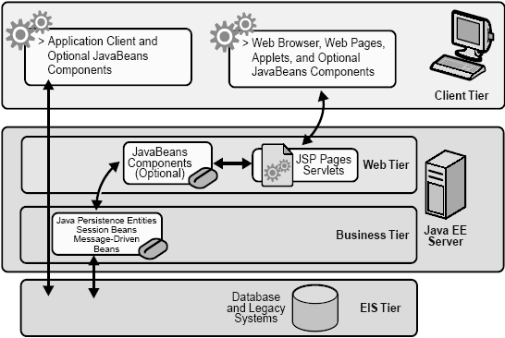
Java EE Application (not strictly tiered)
Thick client
Thin client

Slide 14
Various Middlewares…
DCE,CORBA, OMG, CanCORBA, ORBIX, JavaORB, ORBLite, TAO, Zen, RTCORBA, FTCORBA,DCOM, POA,IDL,IOP,IIOP, ObjectBroker, Visibroker, Orbix, ObjectBus,ESBs
MOM – TIBCO TIB/Rendezvous, BEA MessageQ, Microsoft MSMQ, ActiveWorks
JVM, JINI, RMI, J2EE, EJB,J2ME, JDBC,JTA, JTS,JMS, JNDI,
Enterprise Middleware Technologies -- BEA WebLogic, IBM WebSphere, TivoliBeans
ENCINA, Tuxedo, CICS
SOAP, Web Services, WSDL, BPEL
XML, XQuery, XPath, JSON, MQTT, CoAP
Hadoop, MapReduce, VM, IaaS, PaaS, NaaS, DAS,
14

Slide 15
Distributed Object Architecture
In distributed object architecture:
There is no distinction between clients and servers
Each distributable component is an object that provides services to other objects and receives services from other objects
Object communication is through a middleware system called an object request broker (ORB, also called software bus)
However, more complex to design than client-server systems
No explicit separation of duties – The same person/team designs the same types of objects and the entire system, which requires complex skill to handle.
There are competing standards.

Slide 16
Distributed Object Architecture Example
Objects
ORB / Software Bus
Objects

Slide 17
Advantages of Distributed Object Architecture
It is an open system architecture that allows new resources to be added to it as required;
The system is flexible and scalable;
It is possible (e.g., written in the same language) to reconfigure the system dynamically with objects migrating across the network as required.
It allows the system designer to delay decisions on where and how services should be provided;

Slide 18
Uses of Distributed Object Architecture
As a logical model that allows you to structure and organize the system. In this case, you think about how to provide application functionality solely in terms of services and combinations of services;
As a more flexible approach to the implementation of client-server systems. The logical model of the system is a client-server model, but both clients and servers are realized as distributed objects communicating through an ORB /software bus.

Slide 19
CORBA: Common Object Request Broker Architecture
Defined by the Object Management Group (OMG)
An international standard for an Object Request Broker - middleware to manage communications between distributed objects/components
Enable software components written in multiple computer languages and running on multiple computers to interoperate;
Several implementations of CORBA are available;
DCOM was an alternative (competing) approach by Microsoft to object request brokers.

Slide 20
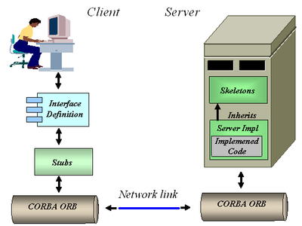
CORBA
CORBA objects are comparable, in principle, to objects in C++ and Java;
The objects have a separate interface defined by the Interface Definition Language (IDL) that is similar to C++;
There is a mapping from this IDL to programming languages (C++, Java, etc.);
Therefore, objects written in different languages can communicate with each other;
CORBA can be used for implementing a Client-Server Architecture →

Slide 21
Object Request Broker (ORB)
Publish / register
The ORB handles object communications.
A service provider makes its services known via stubs.
Agent / broker
Using an ORB, the calling object binds an IDL stub that defines the interface of the called object.
Calling this stub results in a call to the ORB, which then calls the required object through a published IDL skeleton that links the interface to the service implementation.

Slide 22
ORB-based Object Communication
Distributed Object Architecture: Objects can use each other’s services.
IDL
Stub
IDL
Stub
IDL
Stub
IDL
Stub
Object Request Broker
Object Request Broker
Network

Slide 23
MS DCOM: Distributed Component Object Model
Originally, Microsoft distributed object system was called OLE (Object Linking and Embedding) and then “Network OLE”;
It was extended to Microsoft's COM (Component Object Model) in 1993, which provided the communication capacity among objects;
Windows 2000 significantly extended COM and renamed it COM+. Then, COM+ becomes DCOM later;
DCOM allows software components to distribute across several networked computers to communicate with each other;
All these technologies are integrated into and replaced by Visual Studio .NET, which supports both Object-Oriented and Service-Oriented Architecture (SOA).

Slide 24
Classifying Distributed Systems
Based on Architectural Models
Client-Server, Peer-to-peer, Proxy based,…
Based on computation/communication - degree of synchrony
Synchronous, Asynchronous
Based on communication style
Message Passing, Shared Memory
Based on Fault model
Crash failures, Omission failures, Byzantine failures
how to handle failure of processes/channels
24

Slide 25
Enterprise Service Bus (ESB)
Shifting from Distributed Object Orientation to Service Orientation
An ESB provides an abstraction layer on top of an implementation of an enterprise messaging system;
It allows integration architects to exploit the value of messaging without writing code.
It is the service-oriented version of ORB.
Contrary to the more classical Enterprise Application Integration (EAI) approach (tightly coupled), ESB provides a loosely coupled platform to support distributed functions, with distributed (independent) deployment where needed, while still working in harmony.

Slide 26
Modeling Business in SOA
Turn this model …
…into this (SOA).
Depository
Vendor Setup
Vendor
Process Servers
Banks
Customer Perceived
Application
Service
Application
Service
Application
Service
Application
Service
Budget
Maintenance
(Imaging)
NEW Soundscan
Shows
VAN
Universal Account
In-Stock
Analysis Tool
Printer
S20-Sales
Mesa Data
Reconcilliation
Maintenance
Polling
I13- Auto
Hand Scan
Printer PO
Customer
Replenishment
Apps
Reports
Insertions
Sales
Order
Due Dates
Calendar
Orders
Print Costing
Corrections
Warehouse
Broadcast
General
Invoice App
Management
Stores & Mrkts
Filter
Maintenance
Interface
PO
Smart Plus
Millennuim 3.0
Smart Plus
Sales Posting
Launcher
Cell
Return to
Tally Sheet
Millennium
Phones
D01 Post Load
Vendor
Credit App
Stock Options
Employee
Equifax
Billing
Solution
Satellite
Resource
Change Notice
A04 - Cust
Software
System
-Promo
Scheduling
On-line New
Refund Chks
DFK
1
Analysis
Interface
Interface
Interface
Resumix
Hire Entry
P01-
AAS
Price
Employee
Marketing
Cobra
P09 - P17
Masterfile
Support
Bus Systems
Cyb.
ABC
website
- ISP
CTS
Co
Home
Cycle Physical
Tracking
ACH
Prodigy
V04-Sign
Deliveries
Inventory
Banks - ACH and Pos to
POS
System
CTO
-
Pay
Transfers
Host to AS400
Plan Administrators
Communication
(401K, PCS, Life)
Spec Source
Stock
SKU Tracking
Status
Counts
Price
Testing
Supplier
Employee
Intercept
Sales
Scanning
Layaways
Compliance
Purchase
Tax
Spec
PO
Scorecard
Source
Receiving
SKU
Mkt
Performance
Bonus/HR
Reactions
Polling
Price Management
Inventory Info
Coop
SKU Selection
DRK
System
Customer Repair
Tool
ABBX
Tracking
I35 Early Warning
Planning
Rebate
SKU Rep
System
Store
Transfer
SKU
Purchase
Monitor
PowerSuite
General
Information
Order
Ad Expense
Ledger
Store
Tex A
Sign
Scorecard
System
N.
Count Corrections
Store Budget
Interface
Interface
Interface
Interface
Tx
Writer
Merchandise
Media
Reporting
Workspace
Analysis
BMP - Bus
EDI
performance Mngt
Mngr Approval
Coordinator
Batch Forcasting
AIMS
AP
Journal Entry Tool Kit
Ad Measurement
Cellular
INVENTORY CONTROL APPS - PC
INVENTORY CONTROL APPS - PC
ACCTS REC APPS - PC
Ad
AIMS
Rollover
OTHER APPS - PC
Launcher
Reporting
House
PSP
Capital
Op.
Recon
File
Charges
Data Warehouse
In-Home
Projects
SS
Connect 3
Credit
Repair
Connect 3
Connect 3
Cash Receipts/Credit
Application
Service
Application
Service
Application
Service
Application
Service
Fixed
PDF Transfe
Reports
Misc Accounting/Finance Apps - PC/NT
Warranty
Assets
Billing
Repair
Cash Over/
System
Short
Rich business abstractions describe the application interface
Decouples the interfaces from the business applications
The number and complexity of the interfaces are reduced
Business applications and their interfaces become reusable
Source: Carter Sandy Keynote Presentation, IBM, 2005
Notes:
So how does web services decouple the interfaces from their applications?
1) It uses a programming model that allows a rich abstraction of both the business app and the interface.
2) By abstracting the interfaces, they can be clearly separated from the business applications.
3) This enables you to reduce the number and complexity of those interfaces and.
4) It allows you to reuse both the interfaces and the business applications.
The problem is that you still have to build, find, and manage all of those interfaces somewhere.

Slide 27
The ESB shrinks those interfaces further
Turn this (web services)…
…into this (SOA)
Application
Service
Application
Service
Application
Service
Application
Service
Application
Service
Application
Service
Application
Service
Application
Service
Interface
Interface
Interface
Enterprise Service Bus
Interface
Interface
Interface
Interface
Application
Service
Application
Service
Application
Service
Application
Service
Application
Service
Application
Service
Application
Service
Application
Service
Decouples the point-to-point connections from the interfaces
Allows for dynamic selection, substitution, and matching
Enables more flexible coupling and decoupling of the applications
Enables you to find both the applications and the interfaces for re-use
Source: Carter Sandy Keynote Presentation, IBM, 2005
Notes:
The ESB shrinks the interfaces further.
1) It virtualizes the interface, or in other words, it decouples the point-to-point connections from the interfaces themselves.
2) The interfaces are put into a third party broker which helps you manage the interfaces better.
3) The enables faster and more flexible coupling and decoupling of applications.
4) Because you can find all of the applications and the interfaces, you can then reuse both.

Slide 28
Software Engineering Review: Design Patterns
Design patterns will be used in the later chapters
Hardware Patterns
Software Patters
Patterns
Architectural Patterns
Computing Patterns (Computing paradigms)
Design Patterns
A design pattern is a general reusable solution in software design.
A design pattern is not a finished design. It is
A template for solving a problem that can be used in many different situations;
An interface that can have different implementations.
Algorithms of solving a problem is not a part of the design pattern – They belong to the implementation detail / computing pattern.
Not all software patterns are design patterns. Design patterns deal specifically with problems at the level of software design.

Slide 29
Review: Classification of Design Patterns
Creational Patterns: Abstract factory, Factory method, Lazy initialization, Object pool, Singleton, Utility, …
Structural Patterns: Adapter, Decorator, Façade, Proxy, …
Behavioral Patterns: Command, Iterator, Mediator, Observer, State, …
Concurrency Patterns: Active Object, Monitor, Read-Write Lock, Reactor, …

Slide 30
Review: Creational Patterns
Abstract factory: Provide an interface for creating families of objects without specifying their concrete classes.
Factory method: Define an interface for creating an object, but let subclasses decide which class to instantiate. Factory method lets a class defer instantiation to subclasses.
Lazy initialization: Tactic of delaying the creation of an object, the calculation of a value, or some other expensive process until the first time it is needed.
Object pool: Avoid expensive acquisition and release of resources by recycling objects that are no longer in use
Singleton: Ensure a class only has one instance, and provide a global point of access to it.
Utility: A class with a private constructor that contains only static methods.

Slide 31
Review: Structural Patterns
Adapter: Convert the interface of a class into another interface that clients expect.
Decorator: Attach additional responsibilities to an object dynamically. Decorators provide a flexible alternative to sub-classing for extending functionality.
Façade: Provide a unified interface to a set of interfaces in a subsystem. Façade defines a higher-level interface that makes the subsystem easier to use.
Proxy: Provide a surrogate or placeholder for another object to control the access to it.

Slide 32
Review: Behavioral Patterns
Command: Encapsulate a request as an object, thereby letting you parameterize clients with different requests.
Iterator: Provide a way to access the elements of an aggregate object sequentially without exposing its underlying representation.
Mediator between objects: Define an object that encapsulates how a set of objects interact. Mediator promotes loose coupling by keeping objects from referring to each other explicitly, and it lets you vary their interaction independently.
State: Allow an object to alter its behavior when its internal state changes.
Observer: Define a one-to-many dependency between objects so that when one object changes state, all its dependents are notified and updated automatically.

Slide 33
Review: Concurrency Patterns
Active Object: It decouples method execution from method invocation. The goal is to introduce concurrency, by using asynchronous method invocation and a scheduler for handling requests.
Monitor: It is an approach to synchronize two or more tasks that use a shared resource, usually an object.
Read-Write Lock: It allows concurrent read access to an object but requires exclusive access for write operations.
Reactor: It is a concurrent programming pattern for handling service requests delivered concurrently to a service handler by one or more inputs. The service handler then de-multiplexes the incoming requests and dispatches them synchronously to the associated request handlers.

Slide 34
Distributed Development

Slide 35
Distributed Development: Separation of Responsibility
The Three-Party Model of Service-Oriented Software Development
Not a part of the model
Developers who understand database, ontology, searching, and matching
End user
White pages
Yellow pages
Traditional object-oriented programmers, active objects hosting
Software engineers who understand the application domain
Service brokers
Green pages
Registry
Registry
Service repository
Internet
Application builders
Service providers
Applications
Active Objects
Service requesters
Service developers

Slide 36
A Scenario of the SO Software Development and Tools
Programming
languages:
C++, C#
Java, Python
Directory of services
UDDI / WSDL / SOAP
ebXML, RDF/S, OWL
Ontology
(3) Registering
Service
Development Envir:
Visual Studio, Flask, Django
Java EE / Eclipse / NetBeans
Service brokers
Registry
Registry
(5) Found
(2) Publishing
Internet
(4) Finding
Application builder
Service providers
(6) Binding
(7) SOAP/HTTP call
(1) Developing
Applications
Active Objects
(8) Results
Application development platforms
Specification languages VS, WebSphere, SCA/SDO, WF, WSFL, BPEL, Django for composition, code generation, in addition to use programming languages
Using Web Service standards:
XML, WSDL, RDF, OWL, ontology

Slide 37
Web Services in Web Applications
Brokers
Application builders
Service Directory
UDDI or ebXML
Other Web
Services
Service
requesters
SOAP/HTTP
Global Data
WSDL Interface
Local Data
Service / Object
Database and Ontology
IDE (.Net or Java EE)
Big Data
Programming languages
Data Infrastructure
Web Services
Service hosting infrastructure, e.g., servers or cloud computing
A program consists of algorithms and data

Slide 38
Definitions and Terminologies
A service is the interface between the producer and the consumer.
From the service provider's point of view, a service is a function module that is well-defined, self-contained, and does not depend on the context or state of other functions. A service is often implemented by an active object.
Services can be newly developed modules or just wrapped around existing (legacy) software to give them new interfaces.
From the application builder's point of view, a service is a unit of work done by a service provider to achieve desired end results for a service consumer (an application builder, not an end user).
A service normally does not have the human user's interface. Instead, it provides loosely coupled Application Programming Interface (API), with standard interface, so that a service can be discovered and invoked by a computer program.
For human users (end users) to use services, a (graphic) user interface needs to be added – forming a (Web) application.

Slide 39
Definitions and Terminologies (contd.)
Service-Oriented Architecture (SOA): Software consisting of a collection of loosely coupled and platform-independent services that communicate with each other through standard interfaces. SOA does not concern developing operational software.
Service-Oriented Computing (SOC) refers to the paradigm that represents computation in SOA. A level deeper than SOA, incl. algorithms and data structures.
SOA and SOC are often used interchangeably.
Web Services are services accessible over the Web. As an architecture, it refers to Web-based SOA and a set of enabling Web technologies, including XML, JSON, SOAP, WSDL, HTTP, UDDI, and ebXML. Two types of Web services:
SOAP/WSDL Services (heavy duty services)
RESTful Services (lightweight or micro services)

Slide 40
Definitions and Terminologies (contd.)
Service-Oriented Development (SOD)
concerns the entire software development cycle based on SOA concepts and SOC paradigm.
involves current technologies and tools to effectively produce operational software:
Development environments: VS, Java EE, Flask, Django, NetBeans, WebSphere, etc.;
Databases, SQL, Oracle, BD, XML DB, etc.;
Deployment and hosting environment: Server, cloud: SoD, AWS Cloud, Google Cloud, MS Azure, etc.

Slide 41
OO Development versus SO Development
SO Protocols/
Languages
SO Concepts
SO IDEs/Tools
SO Development Cycles
Service
orientation
Loosely
coupled
Remote binding
Dynamic composition
Standard interfaces
XML
WSDL
SOAP
RDF
OWL
BPEL
SCA/SDO
PSML
Visual Studio
Flask, Django NetBeans
Oracle SOA suite
JDeveloper
Java EE
WebSphere
ebXML
Service development in OOC
Interface definition / wrapping
Service hosting / registration
Application specification
Service search
Remote binding
Operation
Dynamic configuration
Directory
Repository
Ontology
Match
OO Concepts
OO Languages
OO IDEs/Tools
OO Development Cycle
Object
orientation
Inheritance
Polymorphism
Dynamic
binding
C++
C#
Objective C
Java
Python
Smalltalk
CORBA
Eclipse
UML
GCC
Visual Studio
Specification/Modeling
Verification/Model checking
Design / Coding
Validation / Testing
Operation
Maintenance

Slide 42
Component-Based Development
Bricks and Tiles
Traditional
Component-based

Slide 43
Component-Based Software Development
Organization X:
Component library
Organization Y:
Component library

Slide 44
Service-Oriented Software Development
Design Pattern?
Application
proxy
proxy
proxy
proxy
proxy
Auto-searchable
Found
Standard
Interface
Service broker
Registration
Organization X:
Component library
Organization Y:
Component library
Organization Z:
Component library

Slide 45
XML
XML (Extensible Markup Language) is a Meta language :
Used for defining other languages. Most languages and protocols in SOC paradigm are based on XML
BPEL (Business Process Execution Language)
RDF, RDF Schema, and OWL
SOAP
WSDL
UDDI
Similar to html to some extent, but you can define your own tags to quote data
You can define attributes to each data item for semantic meanings. Data transferred between Web services are often encoded in XML

Slide 46
HTML versus XML
<html>
<h1>International Conference on Software Engineering and applications, November 14-16, 2005, Phoenix, AZ, USA</h1>
<li>Software design and development</li>
<li>Software engineering applications</li>
<li>Software security</li>
</ br>
</html>
<?xml version="1.0">
<conference>
<title>International Conference on Software Engineering and applications</title>
<date>November 14-16, 2005</date>
<location>Phoenix , AZ, USA </location>
<keyword>Software design and development</keyword>
<keyword>Software engineering applications</keyword>
<keyword>Software security</keyword>
</conference>

Slide 47
Differences between HTML and XML languages
 | HTML | XML
Purpose of tags | Formatting data for display. | Define tags and attributes on data that can be interpreted by human and machine.
Syntax of tags | Tags may be left open, e.g., <li>, <br>. | All tags must be in pair, e.g., <li> </li>, <br> </br>
Semantics of tags | Tags are predefined with given format meaning. Tags are limited. | The user can choose any tags and the meanings can be defined separately. Assigning meanings to a set of tags defines a vocabulary and thus a new markup language.
Schema | The schema is fix and implied | Need a schema file to define the tags and the structure
Semantics of data | It is difficult for machine to understand. For example, is “Phoenix” a part of the title? | Once the tags are defined, it is easy for the machine to understand. “Phoenix” is a location, not a part of the title.

Slide 48
SOAP: Simple Object Access Protocol
SOAP is used for transporting messages between Web services and applications
A SOAP message is an XML document
Like any communication protocol, a SOAP message consists of wrapper information and payload;
The format of SOAP message is as follows:
A SOAP message is often wrapped in an HTTP (Hypertext Transfer Protocol ) message and sent as an HTTP packet over the internet:
<soap:Envelope>
<soap:header> . . . </soap:header>
<soap:body> . . . </soap:body>
</soap:Envelope>
HTTP Package
SOAP Package

Slide 49
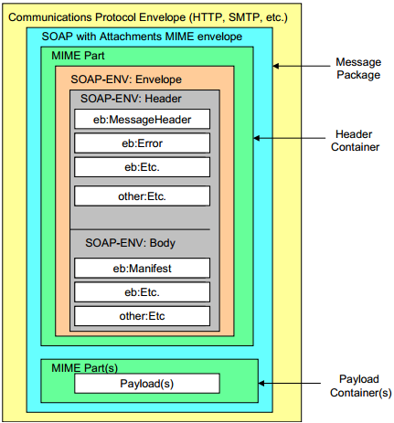
Example: ebXML Message Structure https://www.oasis-open.org/committees/ebxml-msg/documents/ebMS_v2_0.pdf
MIME (Multipurpose Internet Mail Extensions) is a standard that extends the format of email to support:
Text
Non-text attachments
Message bodies with multiple parts
Header information in non-ASCII character sets

Slide 50
WSDL: Web Service Description Language
WSDL is used for describing Web services (interfaces), including four critical aspects of Web services:
Functionality of the services described in standard taxonomy;
Data type of each parameter and the return type of the function (service) call;
Binding information about the transport protocol to be used, usually, SOAP;
Address (URL) for locating the specified service.
The last three aspects can be automatically generated.
Web services described in WSDL can be searched, matched, and discovered based on the requirements.
Web services described in WSDL provides discovery and remote call details.

Slide 51
XML-Based WSDL Document’s Elements
root
<definitions>, service name, namespaces
<Service>
. . .
<Service>
<port>
(URL)
<port>
(URL)
. . .
<binding>
(soap)
<binding>
(soap)
<portType>
<portType>
<operation>
<operation>
<types>
<types>
<message>, in
. . .
<message>, in
<types>
<types>
<message>, out
<message>, out

Slide 52
SOC Services vs. OOC Classes
SOAP/WSDL Services
WSDL interface → Language interface
Namespace of services → Namespace of classes
Service → Class/Object
Operation → Method
Operation type in → Method parameter
Operation type out → Method return value
Binding protocol (SOAP) →
Service address (URL) →
RESTful Services → Resource → Method
Service → Resource → Method

Slide 53
Summery: Key SOA, SOC & SOD Concepts
Component-based composition with open standards and protocols
Remote objects, binding, and remote invocation
Autonomous services with platform-independency: Using proxy, instead of code integration
Loosely coupling using message-based communication and asynchronous communication is supported
Web-based repository of internet-searchable and reusable services
Automatic discovering and binding, based on collaboration negotiation, dynamic re-composition, and ontology-based reasoning.
Separation of development: service provider, broker, client

Slide 54
Web Services

Slide 55
Web Services
Basic Concepts
XML, SOAP, WSDL
Services
Service Broker
Application Building
SOA Impact
Web 2.0 and Semantic Web
Service brokers
Registry
Registry
Application builder
Service providers
Applications
Web Services

Slide 56
Web Service (WS)
Web Services are building blocks of SOC software
SOAP/WSDL services have an standard interface in WSDL
RESTful services use HTTP without using SOAP/WSDL
WS can be remotely invoked via a message in a standard protocol, e.g., SOAP, HTTP – It is NOT a remote procedure call
Loosely coupled vs. tightly coupled
Data flow vs. control flow
Web Services are platform-independent, it can be written in any languages: Java, C#, C++, Python, etc.
Every piece of program can be wrapped into a WS
Every WS can be placed in an internet-searchable repository
In the near future, most services required will be available (not necessarily free). There is less need of writing new services. However, there is always a need of writing better services.

Slide 57
Main Web Service Authoring Tools (1)
C# Web Services on Visual Studio
Choose a Web Service templates, WCF, WF, etc.
Define an ordinary class with data members and mainly methods in C#;
Choose methods to be remotable by adding [operation contract]
Compile and run the class, service will be generated;
WSDL file and/or URL of the Web service will be generated;
SOAP/HTTP call interface will be generated;
There is little difference with writing a C# class

Slide 58
Main Web Service Authoring Tools (2)
Java Web Services
Define an ordinary class with data members and methods in Java;
There are different ways to wrap a Java class into a Web service (generate WSDL and SOAP files)
NetBeans, Download: https://netbeans.org/
Eclipse with WS extension,
Java EE,
Community projects and third parties, e.g., Apache Tomcat tool,
IBM tools such WebSphere, http://www.eclipse.org/webtools/initial-contribution/IBM/evalGuides/WebServicesToolsEval.html
JDeveloper / Oracle SOA Suite
Manually write host and extract the required information and wrap them into WSDL and SOAP syntax

Slide 59
Main Web Service Authoring Tools (3)
Python Web Services
There are different environments for defining Python Web RESTful services
Flask
Django
FasrAPI
CherryPy
Pyramid
Visual Studio + Flask: https://docs.microsoft.com/en-us/visualstudio/ide/quickstart-python?view=vs-2022
Visual Studio + Django https://docs.microsoft.com/en-us/visualstudio/python/learn-django-in-visual-studio-step-01-project-and-solution?view=vs-2022
Grok
TurboGears
Web2Py
Bottle

Slide 60
Web Services are Wrapped Classes/Objects
Return value in XML/SOAP/HTTP
To UDDI server
Service
requester
Remote invocation in
XML/SOAP/HTTP
WSDL Description for UDDI publication
RESTful
Reactor
Web service interfaces in WSDL
Automatically
generate the
Service interfaces
Function call
Return value
Service agent
Functions/Methods written in C# / Java / Python
Manually write the functions/methods in the classes in C# or in Java, each function corresponds to a service

Slide 61
Roadmap
Basic Concepts
XML, SOAP, WSDL
Web Services
Service Broker: Registry and Repository
Application Building
SOA Impact
Myths and Facts
White pages
Yellow pages
Service brokers
Green pages
Registry
Found
Internet
Publishing
Find
Application builder
Service providers
SOAP call
Applications
Web Services
Results

Slide 62
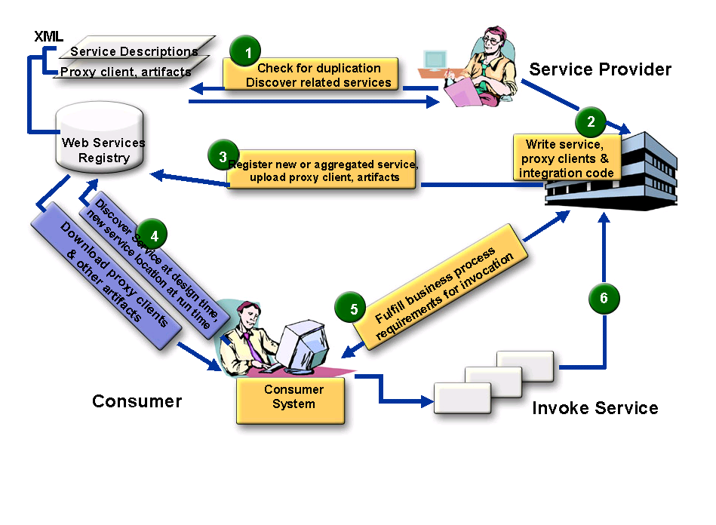

SOA Three Party Model with More Detail
Service Broker
5
4
Define policies: visibility, access, lifecyle stage, etc.
Application
builder
Service Administrator
Service Consumer
Application Builder
End user

Slide 63
Different Kinds of Service Brokers
Service
Brokers
OASIS Standard
UDDI Registry
Limited
automation
OASIS Standard
ebXML Integrated Registry/Repository
Extensive
automation
Ad Hoc
Registry / List
Quick start
Manual
search
Large IT companies
MS, IBM, SAP, HP
Small / Medium IT
Non IT (Boeing)
Government
Small companies
www.programmableweb.com/
ASU Repository
Your Project 3

Slide 64
Who is OASIS?
OASIS is a member-led, international non-profit standards consortium;
Founded under the name "SGML Open" in 1993.
Thousands of individual and organizational members in 100 countries;
The largest standards group for SOA and Web services. Most SOA standards are from OASIS
Supports over 60 technical committees producing royalty-free and RAND (Reasonable and non-discriminatory) licensing in an open process.

Slide 65
UDDI Service Registry, Universal Description, Discovery, and Integration
UDDI registry information is organized in three groups:
White pages include service provider's name, identify, e.g., the DUNS number, contact information.
Yellow pages include industry type, product and service type, and geographical location.
Green pages include five data structures and APIs for allowing computer programs to read and write (register) UDDI registry.

Slide 66
ebXML Consists of Five Modules
http://www.ebxml.org/
Similar to BPEL and Workflow Foundation
Business Process Specification Schema
Core Components
Collaboration Protocol Profiles and Agreements (CPPA)
Message Service https://www.oasis-open.org/committees/ebxml-msg/documents/ebMS_v2_0.pdf
Registry & Repository
ebXML Message
Format

Slide 67
ebXML Vendor Products
Sun Microsystems Inc.
ebXMLsoft Inc.
CHECKMi
Digital Artefacts Inc.
Adobe Systems Inc.
freebXML Registry (open source)
Infravio - X-registry
Xenos Group Inc. – GoXML Registry
Widely used in healthcare systems and government systems

Slide 68
What is ebXML?
An SOA registry as well as a repository
Classification of any type of information
Managing relationships between information
Taxonomy hosting, browsing and validation
File/folder organization of information
A content management system for secure & federated information
Provides services for sharing content and metadata between entities in a federated environment
Lifecycle Management (LCM) actions logged in an audit trail
Supports automatic versioning of objects

Slide 69

ebXML Registry Key Features
Registration, Discovery, Queries
ebXML Registry
Federated Queries, Inter-registry links
Registry
Repository
Taxonomies, Classifications, Associations
Federated Information Manage- ment
Standard Metadata
Secure Architecture
Content management
Cataloging, Content Validation, Version Control, Lifecycle Support, Extensible Information Model
Digital Signatures, Audit Trail, Access Control, SAML Single Sign-On
Events
Content-Based Event Notification

Slide 70
Need for an Integrated SOA Registry/Repository
Governance enforced where SOA artifacts are stored
Registry is not enough – need repository
Repository stores the actual artifacts
Registry stores metadata about the artifacts
An integrated registry/repository ensures consistent storage, management, and reuse of artifacts according to organizational policies
ebXML registry provides an integrated registry/repository
Empower service providers without their own servers

Slide 71
Federated Information Management
Multiple ebXML registries may be federated together to
appear as a single virtual registry/repository
support seamless information integration and sharing
allow local autonomy over data
ebXML federated registry relies on SAML (Security Assertion Markup Language) – the federated identity management standard

Slide 72
Case Study: Government of Canada/Ontario
Vision: Improve service quality to Canadian people and businesses through cost-effective eServices at all levels of government
Target: Leverage the power of XML to deliver those services via collaboration across jurisdictions
Strategy: Enable service delivery infrastructure by utilizing a federated registry and repository

Slide 73

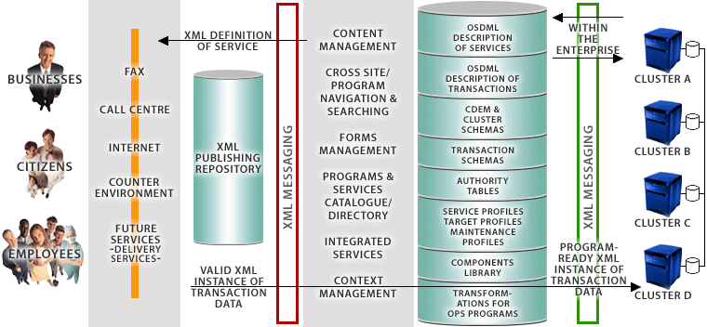




Government of Canada’s Registry/Repository enables Four-Tier e-Government Architecture
ebXML Registry/ Repository
End Users
eContact
CSDML
CBSC
META DATA
CALL CENTRE
CLUSTER SCHEMAS
PORTAL
CSPN
TRANSACTION SCHEMAS
COUNTER ENVIRONMENT
SECURITY
CPSIN
FUTURE SERVICES
- DELIVERY SERVICES -
GSRM Models
BizPal
COMMON COMPONENTS
TRANSFORMATIONS FOR PS PROGRAMS
Presentation Layer
Application Layer
XML Integration Layer
Back-End Layer
Source: Government of Canada

Slide 74
HTTPS Access to ASU Repository
HTTPS: HTTP with SSL (Secure Sockets Layer)
Starting from 2022, ASU requires all accesses to ASU servers to use HTTPS, instead of HTTP.
When you develop a Web application to invoke WSDL web services in ASU Repository, you must use https.
You can open the Web.config file of your Web application and change all http to https and http bindings to https bindings

Slide 75
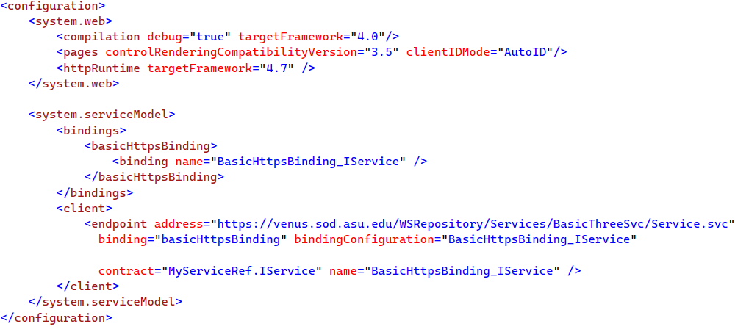
Example

Slide 76
Roadmap
Basic Concepts
XML, SOAP, WSDL
Web Services
Service Registry and Repository
Application Building
SOA Impact
Myths and Facts
Service brokers
Registry
Registry
Application builder
Service providers
Applications
Web Services

Slide 77
Process of Application Building in SOA Style Architecture-Drive Approach
Oracle SOA Suite
Visual Studio WF
Architecture / Component Interface
Level Specification
IBM WebSphere SCA / SDO
IBM WSFL’s Global Model
CSE446 (Integration)
IBM WSFL’s Flow Model
Process / Workflow Level Specification
Microsoft XLANG
BPEL
OWL-S
Code-Level (C#, Java) Assembling and Binding of Components
WSDL
SOAP
CSE445 (Development)
HTTP / RESTful
Deployment
Remote Desktop
FTP / WebDev
Management
IDE (e.g., ebXML, VS)
IDE (e.g., ebXML, VS)

Slide 78
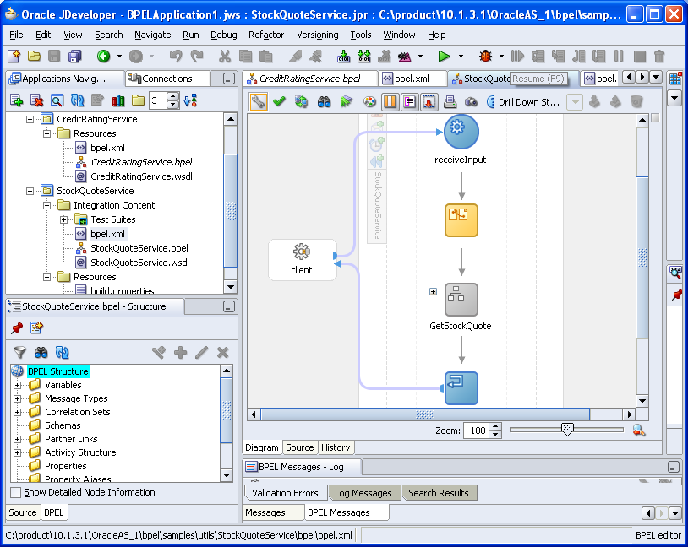
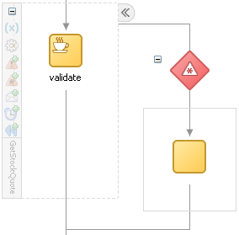
Oracle SOA Suite: StockQuoteService
BPEL composition with WSDL interface

Slide 79
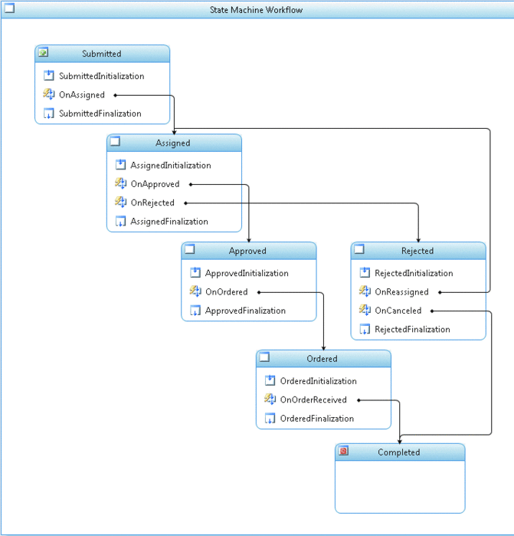
Microsoft Workflow Foundation
Submitted
Assigned
approve
Approved
Rejected
reassign
cancel
Ordered
Completed

Slide 80
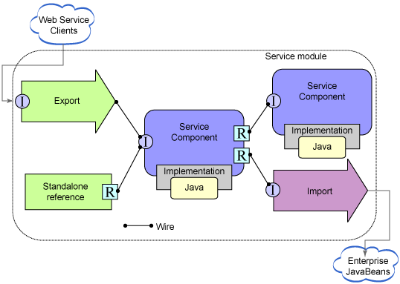
Service Component Architecture (SCA) Service Data Object (SDO)
https://www.ibm.com/support/knowledgecenter/en/SSMKHH_10.0.0/com.ibm.etools.mft.doc/ac68550_.htm

Slide 81
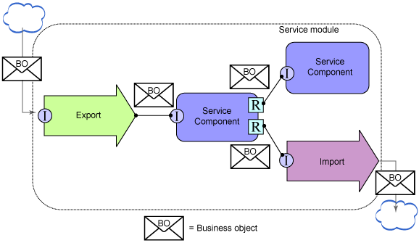
Service Component Architecture (SCA) Service Data Object (SDO)

Slide 82
BPEL
Business Process Execution Language (BPEL) is jointly developed by multiple companies
A global model consists of partners and partner links
A flow model defines the workflow
BPEL provides constructs to specify the data and control flows, including:
Assign
Condition
Switch
Loop
etc.

Slide 83
Impact of SOA/SOC Paradigm
Explicit differentiation between software engineers and programmers (Three-Party Development Model)
Application builders (software engineers) do not have to focus on programming in the small
Programmers do not have to understand application domain
Tougher but equal competition
Shorter development cycle
Better and more reliable software from specialized providers
Different skill requirements:
Fewer programmers-only jobs may be needed, as reuses increase, automated programming, etc.
More software engineers (CS/CSE/SE graduates) will be needed, as applications increase

Slide 84
Myths and Facts of SOA
Myth | Fact
SOA is a technology. | SOA is a design philosophy independent of any product, technology, or industry trend.
SOAs require Web Services. | SOAs can be realized using Web services, but using Web services will not necessarily result in a SOA.
SOA is new and revolutionary. | EDI (Electronic Data Interchange), CORBA, and DCOM were conceptual examples of SOA.
SOA ensures the alignment of IT and business. | SOA is not a methodology.
A SOA Reference Architecture reduces implementation risk. | SOAs are like snowflakes: No two are the same.
SOA requires a complete technology and business-processes overhaul. | SOA should be incremental and built on your current investments.
SOA requires an army of consultants. | SOA requires tools, not consultants.
We need to build a SOA. | SOA is a means, not an end.

Slide 85
Seven Fallacies of SOA
There's Nothing New Under the Sun, and SOA Is No Exception;
SOA is a Revolutionary Paradigm Shift;
SOAs are All Hype, No Substance;
SOA is a Panacea;
The Overhead from SOA Leads to Unacceptably Poor Performance;
A Bottom-Up Approach to SOA is Good Enough;
SOA is Optional.
https://doveltech.com/innovation/seven-fallacies-of-soa/
By Jason Bloomberg

Slide 86
How Does SOA Address the DC Fallacies ?
SOA does not have to be Web based. All services could be local! SOA is independent of topology;
platform; and
location.
The network is reliable.
Latency is zero.
Bandwidth is infinite.
The network is secure.
Topology doesn't change.
There is one administrator.
Transport cost is zero.
The network is homogeneous
Race between communication and computing: who wins?
Latency and bandwidth, which one is harder to resolve?
Moore's law: processor power, network speed, and storage size are all increasing exponentially even as their costs drop
SOA uses end-to-end communication
Orchestration (central controlled) versus Choreography (distributed)
This is one of the costs of distribution
SOA is platform independent!

